Slide 1
Open Source Dev Lab
Patrick McCormick

Slide 2
Project Description
KMOD – Linux userspace module utilities:
lsmod, modinfo, depmod, insmod, rmmod, weak-modules
Add an option to print out nicely formatted symbol-level dependencies
Intended to help during kernel module development

Slide 3
Linux modules in 1 minute
int init_module(void *module_image, unsigned long len, const char *param_values);
int finit_module(int fd, const char *param_values, int flags);
module_name is an elf image.
Kernel contains runtime linker.
Module directory layout, precedence, order is defined by userspace.
Module dependencies, symbols versions, keys, params, etc set at compile time.
See:
/proc/modules
/sys/module/*

Slide 4
The work
Some time reading kmod code: “OO” C, clean.
Modified depmod vs making separate utility
Had to modify internal structs to keep more info around.

Slide 5
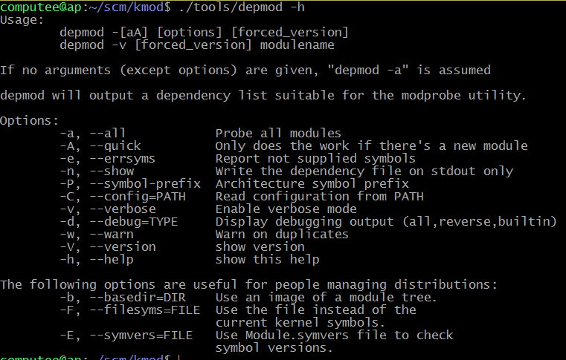
The work

Slide 6
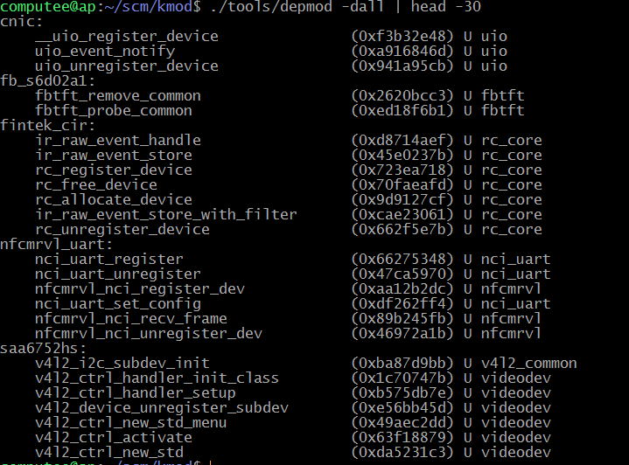
The work

Slide 7
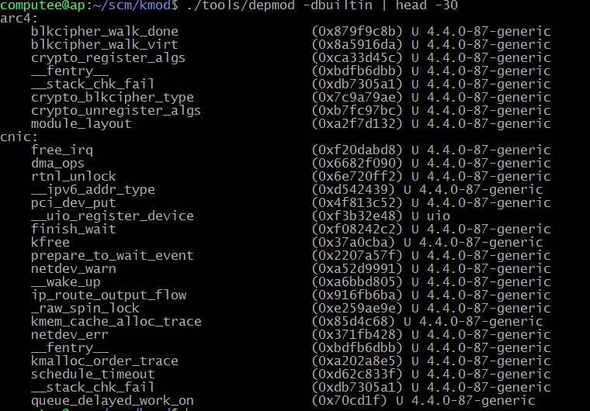
The work

Slide 8
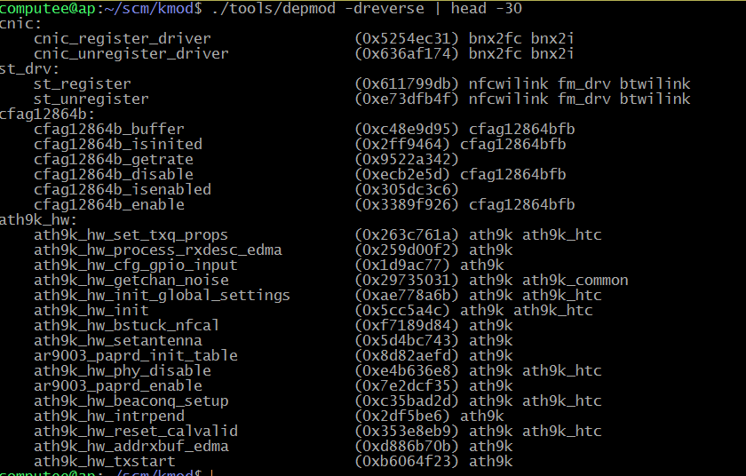
The work

Slide 9
Still can be done
* Only allocate list when –d options are given
* Smarter, size-aware display
* Fix how depmod processes cmd line?
* Man page / docs
* Bash completions

Slide 10
Trip to New Relic
https://www.habitat.sh/ “Automate any app, anywhere with Habitat”
Presentation by program manager, 1+ hours, mostly high level.
System to deploy/manage apps onto virtual machines, bare metal machines, cloud (Amazon, etc).
Does many things: build env, packaging format, health monitor.

Slide 11
Conclusion
Fun project, could have been more work.
Learned some new stuff.

